Slide 1
Predicting Housing Prices
Data 621 Final Project
Group Members:
Eric Hirsch
Cameron Smith
Carlisle Ferguson

Slide 2
Summary
Data Set from Kaggle used
Contains sales records of homes in Iowa from between 2006 - 2010
The dependent variable is SalePrice
7 different types of regression-based models were built
Our group’s project is focused on predicting the sale prices of houses

Slide 3
Types of Models Used
Ordinary Least Squares Regression (OLS)
Ridge Regression
Lasso Regression
Elastic Net
Decision Tree
Random Forest
Gradient Boosting
Performance Summarized In Following Slides

Slide 4
Data Exploration
Key Facts:
1460 observations
81 variables
Numeric and categorical
Target variable: SalePrice
Ranges from $24,950 to $7,550,000
Median of $163,000 suggesting some skewness
Missing data
6,945 total missing values
From 15 different variables
Starting with summary statistics, we explored the data set to identify the type and quality of data

Slide 5
Data Preparation
Missing values fixed
Unimportant variables removed
Remaining data imputed via means
Dummy variables created
Categorical NAs -> dummy variable for NA
Check for multicollinearity
No significant issues identified at this stage
Apply transformations
Log of SalePrice
Additional dummy variables created
Outliers eliminated by setting GrLivArea < 4000
The data was then prepared prior to building models

Slide 6
Model and Predict

Slide 7
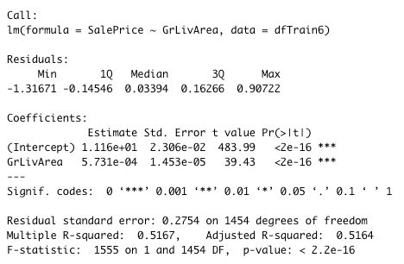
Base Model (OLS)
The first model was built using OLS and applying stepAIC
Adjusted R-squared was .51
Kaggle score of .14586 obtained

Slide 8
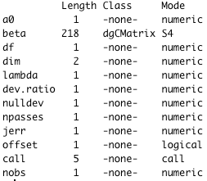
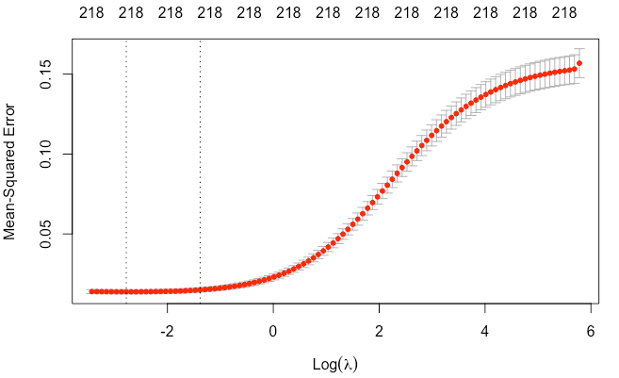
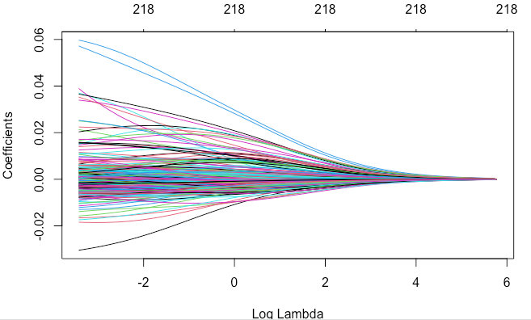
Ridge Regression
The second model was built using ridge regression
All variables retained
K fold validation used to identify best lambda (GLM package)
Kaggle score of .14047 obtained, which is the 40th percentile
Significant improvement over OLS model

Slide 9
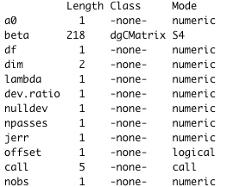
Lasso Regression
The third model was built using lasso regression
K fold validation used to identify best lambda (GLM package)
Coefficients found using optimized lambda
Tried with scaled and unscaled data (scaled performed better)
Kaggle Score of .1375 obtained, outperforming ridge regression

Slide 10
Elastic Net Regression
The fourth model was built using elastic net
Model optimized based on tuning parameters from model training
The result was better than ridge regression, but not as good as lasso regression

Slide 11
The Science Behind the Model
Why did the Lasso model outperform the other regression models?
Similar to Ridge, the Lasso formula contains a penalty on the coefficients, which helps prevent overfitting
Unlike Ridge, Lasso’s penalty system allows coefficients to go to zero, which eliminates unneeded variables
Reducing bias in the model leads to a model that better fits the data.

Slide 12
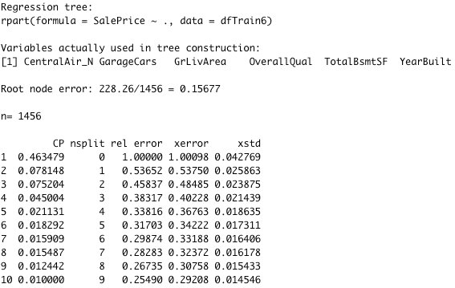
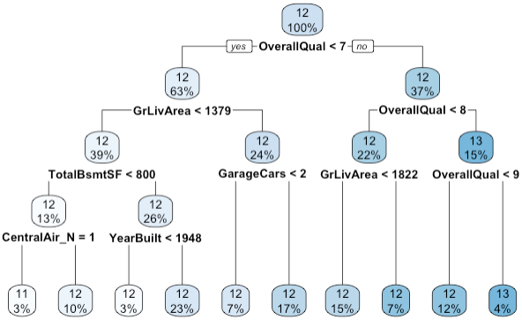
Decision Tree
The fifth model was built using a decision tree
Regression tree built using the rpart package
Root note error of 0.16 (% of correctly sorted results after first node)
Kaggle score of .22422 obtained, which is the lowest scoring model

Slide 13
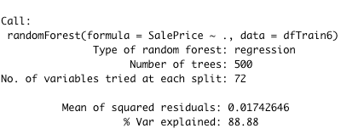
Random Forest and Gradient Boosting
The final models were built using random forest and gradient boosting
Random forest and gradient boosting are similar, but RF combine the trees at the end of the process and GB combines them at the beginning
RF did not improve our score, but GB did
Kaggle score from gradient boosting of .12786 obtained, which is the best of all models

Slide 14
Conclusions
All models, other than the decision tree, performed relatively well
Gradient boosting performed the best followed by lasso regression
Regularization improved our models, but not dramatically
It is important to recognize the strengths of each technique and what is most appropriate for the specific situation

